Slide 1

Slip On Sconce Manufacturing Feasibility
Project Director: Hailey Tamara
Project Team: Noah Pidding (Lead), Phoebe Eplett, Demetri Dean, Zoe Maheras, Evan Banwart
Notes:
15 sec

Slide 2
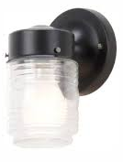
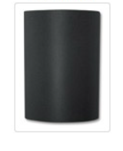
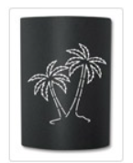
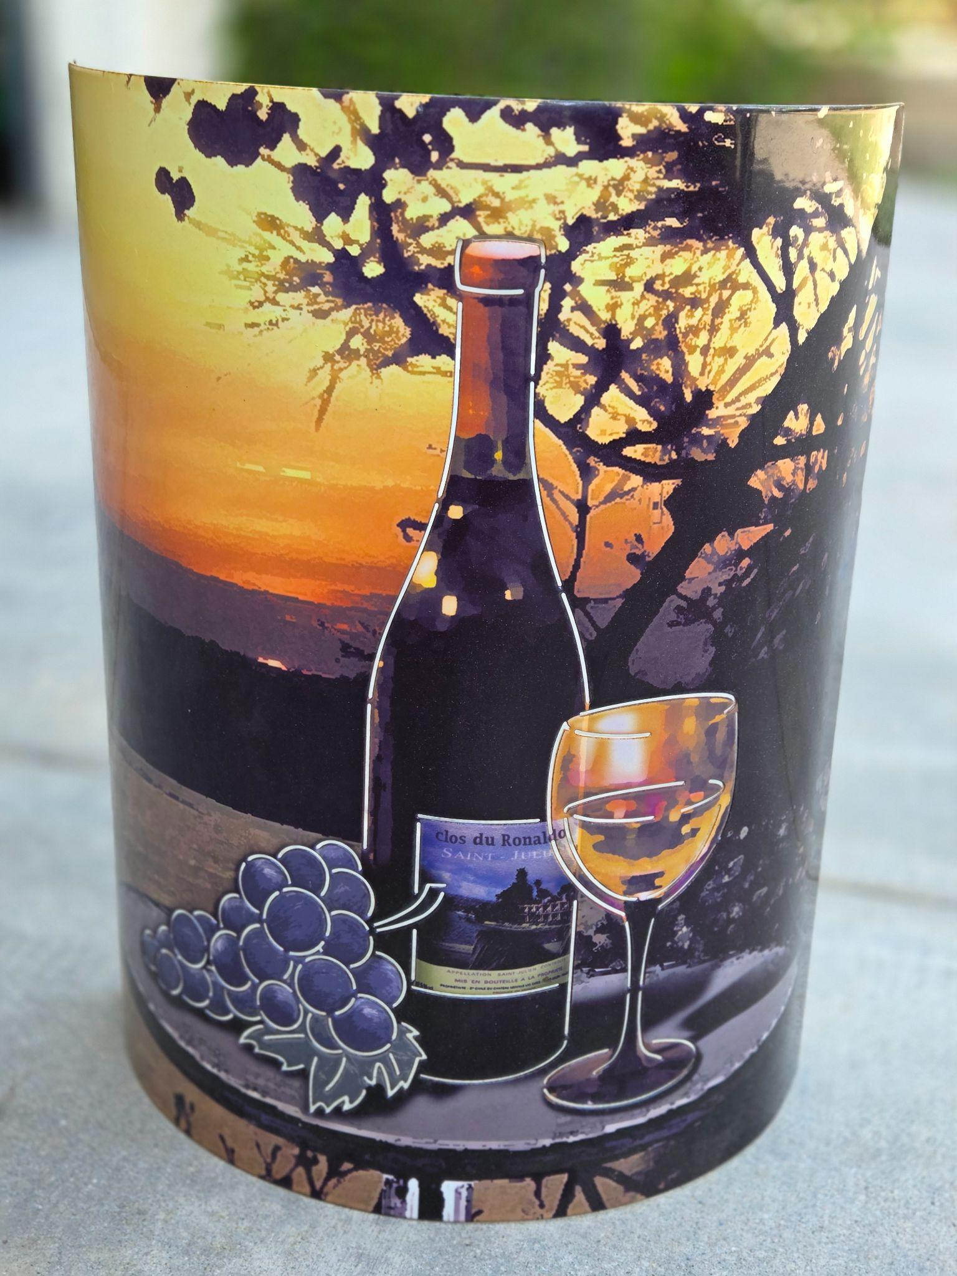
What is Slip On Sconce?
Slip On Sconce is a patented retrofit lighting accessory that transforms standard jelly-jar fixtures
Sponsor: Sean Genovese
Manufacturing stopped in 2017, leaving unmet consumer interest and no active supply
Jelly Jar Lighting Fixture
Standard
Engraved
Custom Engraved
Notes:
Evan
40 sec

Slide 3

Research Questions
Is there sufficient market demand to justify relaunching?
Can a U.S. manufacturer make this product at a reasonable cost?
Notes:
20 sec
good overall less wordy

Slide 4

Goal Statement
Assess Feasibility:
Identifying qualified domestic manufacturers, evaluating IP considerations and comparing production costs to retail pricing and sales volume.
Scope of Deliverables:
The project concluded with a data driven “Go/No-Go” recommendation for full-scale manufacturing.
Notes:
Evan
25 sec
- bold keywords, change font
combine into one sentence

Slide 5
Methodology
Market
Analysis
Competitor Landscape
Survey
TAM
Manufacturing Research
Supplier Search
Outreach
Manufacturing Shortlist
Notes:
Phoebe (a bit under 1 min)
What approaches did you use to accomplish goals (aka milestones)
Steps to reach solution(s)
phases of the project → ie what were the different main focuses you were working/are planning to work on during the project timeline
summarize each phase
include some of the tools and research done in each phase

Slide 6
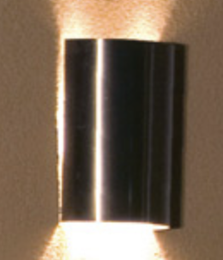
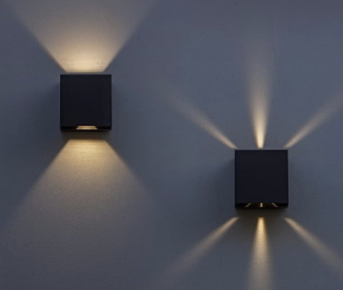
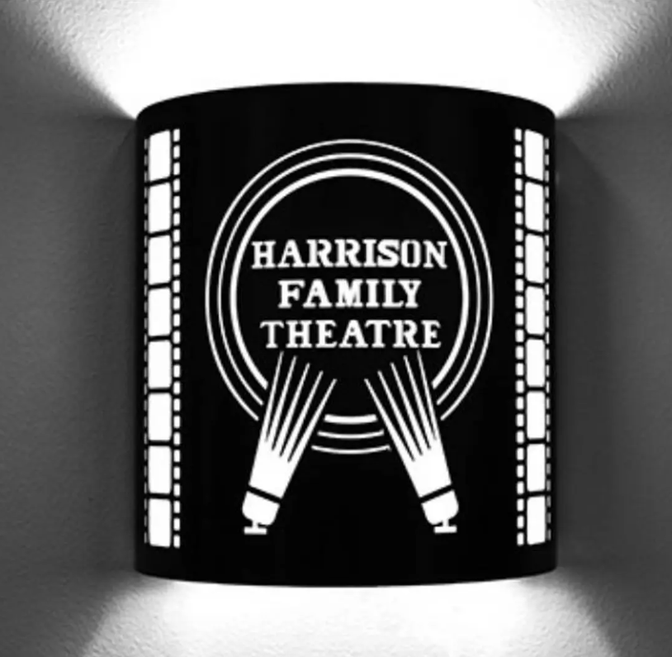
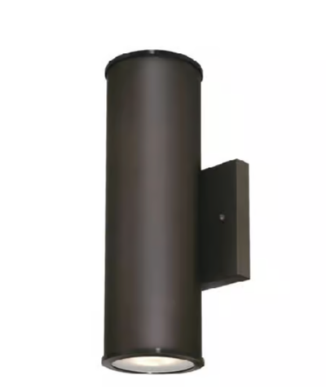
Market Research Overview
Identifiable Markets
1. Custom/Personalized
3. Integrated Light
2. Decorative Outdoor
4. Easy Installation
Customers
Primary:
Secondary:
Homeowners
Airbnb Hosts
Gift Buyers
&
Notes:
Zoe (~30 seconds)
long slide - what do people really need to know? just be way less detailed
split into 2 slides? top graphic and customer
keep customers short - it’s self explanatory
examples photo on each end - one expensive niche, other cheap

Slide 7
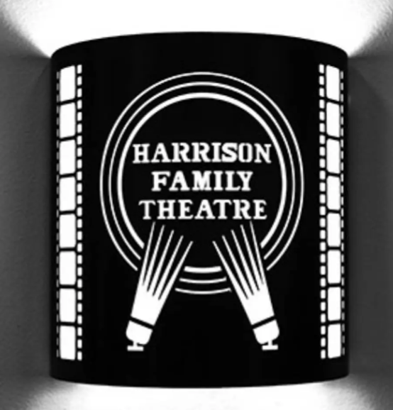
Key Findings of Market Research
Mass Market:
Generic, non-customizable
Middle Niche Market: Slip On Sconce
Niche Market:
High-end, custom or tech-focused
Notes:
Zoe - (~30 seconds)
long slide - what do people really need to know? just be way less detailed
split into 2 slides? top graphic and customer
keep customers short - it’s self explanatory
examples photo on each end - one expensive niche, other cheap

Slide 8

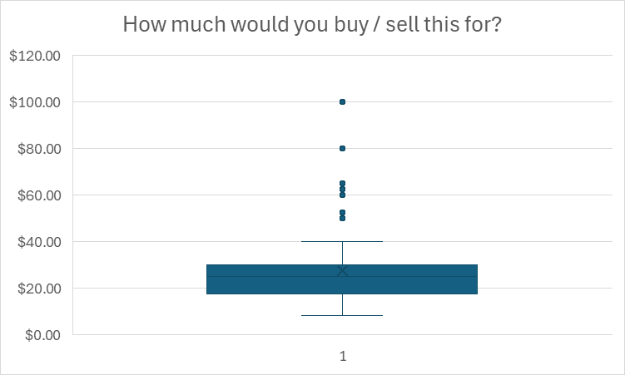
Survey Outreach
Results (93 responses)
1) Do they have lighting fixtures? 2) Would you buy this for your home?
3) How much would you buy / sell this for?
Yes - 53%
No - 47%
Yes - 42%
No - 58%
$0 $20 $40 $60 $80 $100 $120
*Note: Survey sample contains bias and skews toward California homeowners
Min: $8 Median: $25 Max: $100
Mean: $28
Notes:
2 min
Noah - good one!
Font change!
just be more succinct - don’t say % numbers

Slide 9

Market Potential (TAM)
Total Addressable Market = Market Size x Conversion Rate x Price
Millions of U.S. homes could use this product
Adjusting for compatibility and survey interest → ~400k realistic buyers
Demand exists, but low willingness to pay ($20–30 range)
Notes:
1 min 20 sec
Noah - good slide! darker colors - try darker background? make trapezoids
TAM = Potential buyers × Conversion × Price
Adjusted to be more conservative because:
Not all homes have compatible fixtures
Survey showed limited interest & low prices
Launch will start small
Key Takeaways:
Market smaller than expected
Revenue limited at current pricing & niche market
TAM shows demand, but costs make it unrealistic
TAM shows some potential (hundreds of thousands of units possible), when you combine it with your other findings — high production costs, low willingness-to-pay from the survey, and lack of full-service manufacturers — the numbers don’t actually add up to a profitable or realistic business case.

Slide 10
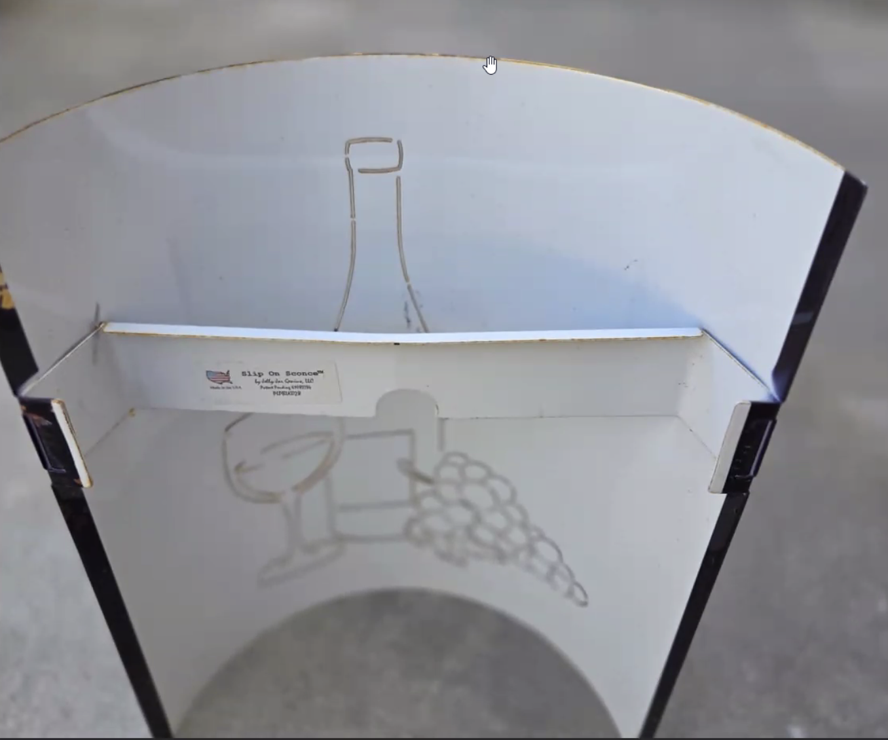
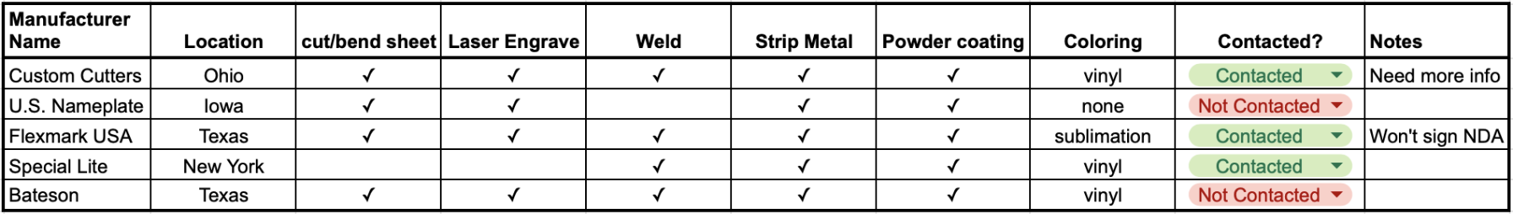
Manufacturing Research
Total Vendors Contacted: 93
Key Criteria: Local, Cut/Bend, Engrave, Weld, Strip, Coat, Color
Questions Asked: Capability, Price, MOQ
Notes:
Demetri
good one

Slide 11
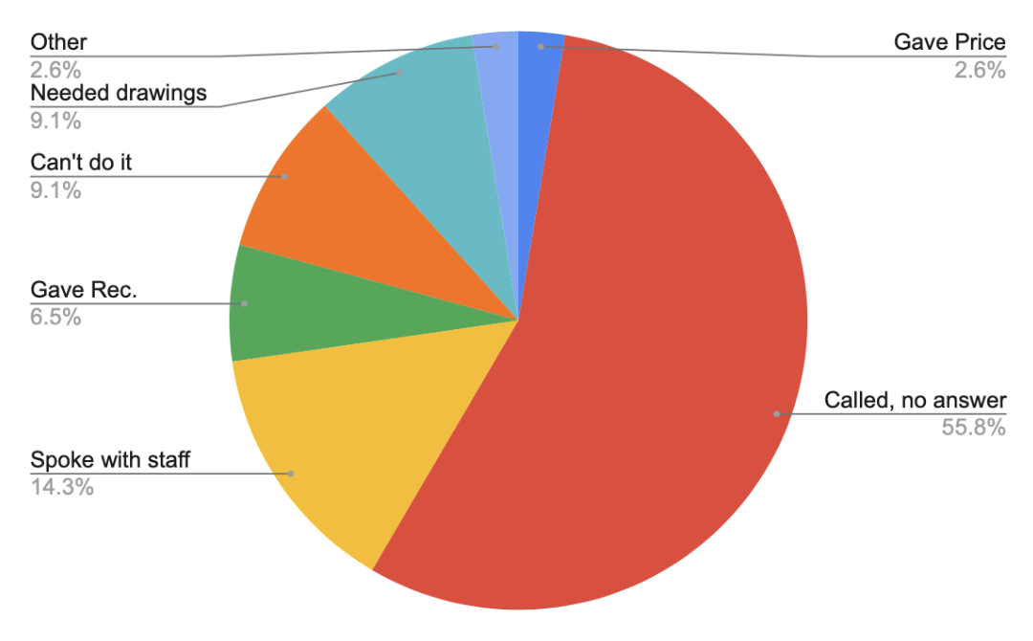
Manufacturing Research - Timeline
Phase # | Phase Name
1 | Capabilities & Initial Outreach
2 | Targeted Outreach & Challenges
3 | Follow-up Actions
Response Overview
Notes:
Demetri
summarize - we had 3 phases, realized we needed to only make plain ones (really simplify)
make chart explanation simpler too

Slide 12
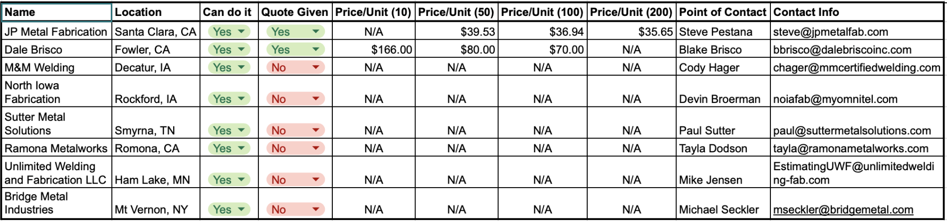
Manufacturing Shortlist
Notes:
Pheobe (45 sec)
mention price point $35 - highlight lowest
don’t walk through every column, quickly reference survey

Slide 13



Final Recommendation
At this moment, given the current manufacturing estimates and our survey outreach responses, we do not find the revival of Slip On Sconce feasible.
Deliverable Handoff
Executive Summary
Marketing
Documentation
Manufacturing
Documentation
Notes:
Zoe (~55 sec-1 min)
5 icons - the noun project
don’t need sub bullets
final rec separate slide?

Slide 14
Recommendation for Next Steps
Explore International Options
Create Engineering Drawings
Re-Engage Manufacturers
Validate Demand
Mexico / Asia to reduce COGS
Finalize CADs & specs
Share drawings & follow up
Run pre-sales (Kickstarter or Etsy pre-orders)
Notes:
50 sec
Noah

Slide 15
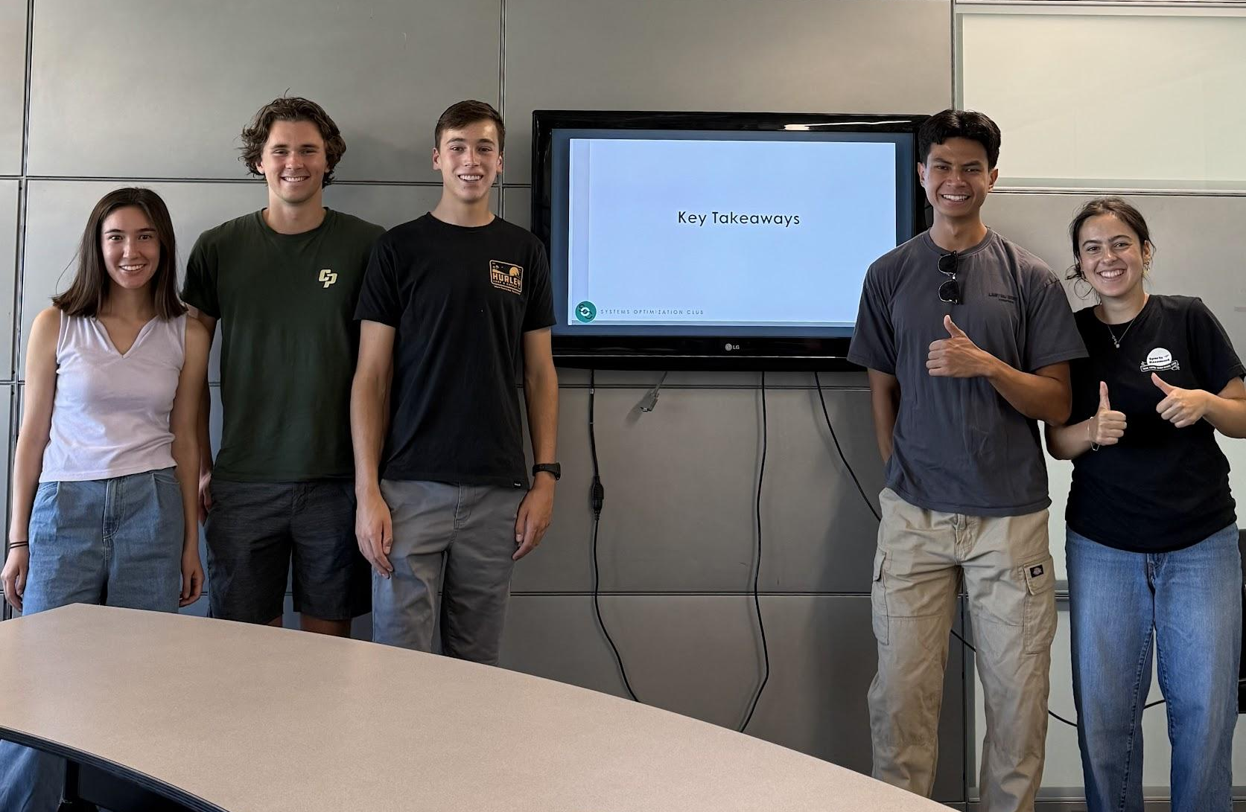
Key
Takeaways
Notes:
a phrase or one sentence

Slide 16
Questions?

